Slide 1
Word Vectors & Word2Vec
Safaa Moallim
Artificial Brain Research Lab., School of Artificial Intelligence, Kyungpook National University
17-Jul-2020

Slide 2
Contents
Word Vectors
Word2vec
skip grams
CBOW (continuous bag-of-words)
Glove (Global Vectors for Word Representation)
Word Sense

Slide 3
Word Vectors
Notes:
Google Deepmind ppt: https://cs230.stanford.edu/files/C5M2.pdf

Slide 4
Word Vectors
Word vectors are simply vectors of numbers that represent the meaning of a word.
Why do we need word vectors?
Deep learning models can perform calculations only on numerical data not text.
So, we need to transform text to numbers.
V: vocabulary size

Slide 5
One-hot vector
In order to use text with a neural network, we need to embed said text into a numerical vector of fixed-size.
One of the Embedding ways is called One-Hot Vector.
one-hot vector
shape: (1, V)
Hello,
0 0 0 … 1 0 0 … 0
I
1 0 0 … 0 0 0 … 0
am
0 0 … 1 0 0 … 0 0
Lookup table
a
Each word is associated
with a sparse vector of 0s and one 1.
0 1 0 … 0 0 … 0 0
student.
0 … 0 0 0 … 0 1 0
Text
(human)
Numerical vector
(computer)
V: vocabulary size

Slide 6
One-hot vector
In order to use text with a neural network, we need to embed said text into a numerical vector of fixed-size.
Issues:
Not efficient
Results in extremely large and sparse representation vectors: a language with vocabulary of 40,000 words would have a one-hot vector of length 40,000.
Curse of dimensionality when learning joint probability functions of language models.
One-hot vectors cannot understand similarities between words.

Slide 7
Distributed Representation
To solve one-hot encoding problems, we need another way of embedding words.
A word representation that encodes similarity wins but why?!
Less parameters to learn.
More sharing of statistics.
More opportunities for multi-task learning.
You can get a lot of value by representing a word by means of its neighbors
“You shall know a word by the company it keeps” (J. R. Firth 1957: 11)

Slide 8
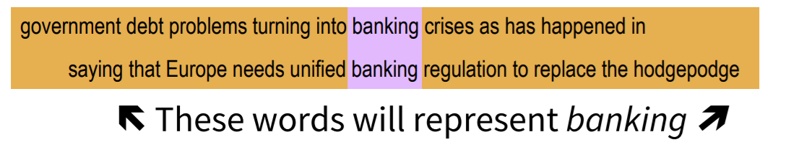
Distributed Representation

Slide 9
Distributed Representation
one-hot vector
shape: (1, V)
featurized representation
shape: (1, E)
Hello,
0 0 0 … 1 0 0 … 0
10 12 6 … 1 2 8
I
Matrix of shape (V, E)
am
…
…
Lookup table
a
Lookup table #2
student.
0 … 0 0 0 … 0 1 0
1 4 … 11 13 20
Text
(human)
Numerical vector
(computer)
Meaningful word
embedding
V: vocabulary size
E: embedding dimension
Notes:
Original paper: https://papers.nips.cc/paper/5021-distributed-representations-of-words-and-phrases-and-their-compositionality.pdf
Wrod2vec in tensorflow: https://towardsdatascience.com/learn-word2vec-by-implementing-it-in-tensorflow-45641adaf2ac

Slide 10
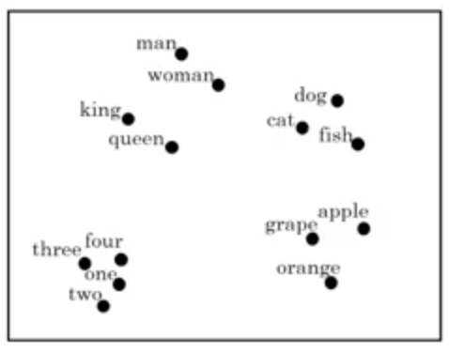
Word Embedding
More meaningful
Distributional hypothesis: "words with similar meanings tend to occur in similar context”
Vectors exhibit compositionality (man+royal=king)
“I want a glass of water”
similar
“I want a glass of juice”
Image source: http://www.ashukumar27.io/WordEmbeddings/
Notes:
Visualization with t-SNE: http://www.ashukumar27.io/WordEmbeddings/

Slide 11
Word Embedding
Limitations:
Inability to represent phrases
Learning of embeddings is based only on a small window of surrounding words (good and bad words might have similar embeddings, not ideal for sentiment analysis)
Highly dependent on the applications in which it is used
Unable to account for polysemy (same word having different meanings)
Notes:
Original paper: https://papers.nips.cc/paper/5021-distributed-representations-of-words-and-phrases-and-their-compositionality.pdf
Wrod2vec in tensorflow: https://towardsdatascience.com/learn-word2vec-by-implementing-it-in-tensorflow-45641adaf2ac

Slide 12
Other embeddings
Token embeddings
Embed root of words
Fewer embeddings: prefix and suffixes can then be used for other words as well
Character embeddings
Embed each letter of the alphabet instead of each word
Advantages: alphabet is always limited and usually small
Solves unkown (UNK) or out-of-vocabulary (OOV) issue since the embedding is really only on the alphabet
learn
-ing
cook
-ed
jump
-s

Slide 13
Word2Vec

Slide 14
Word2Vec
Word2vec is a group of related models that are used to produce word embeddings.
Two-layer neural networks: that are trained to reconstruct linguistic contexts of words
Two different model architectures: CBOW and skip grams

Slide 15
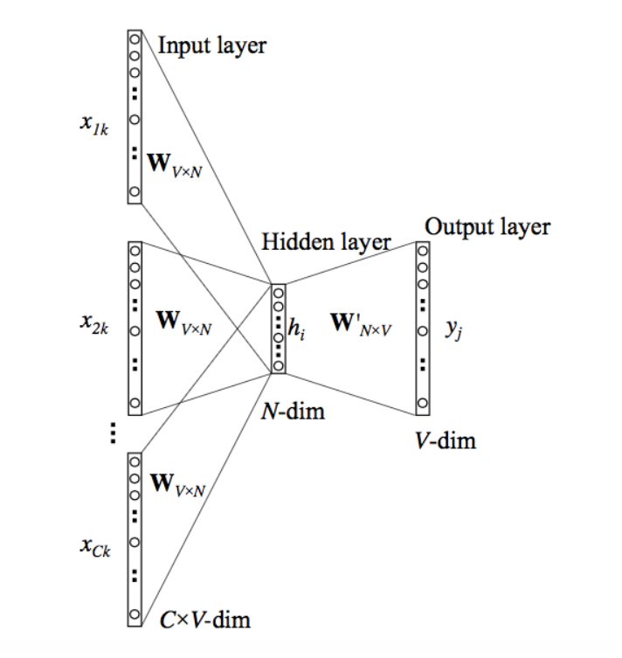
CBOW
This method takes the context of each word as the input and tries to predict the word corresponding to the context.

Slide 16
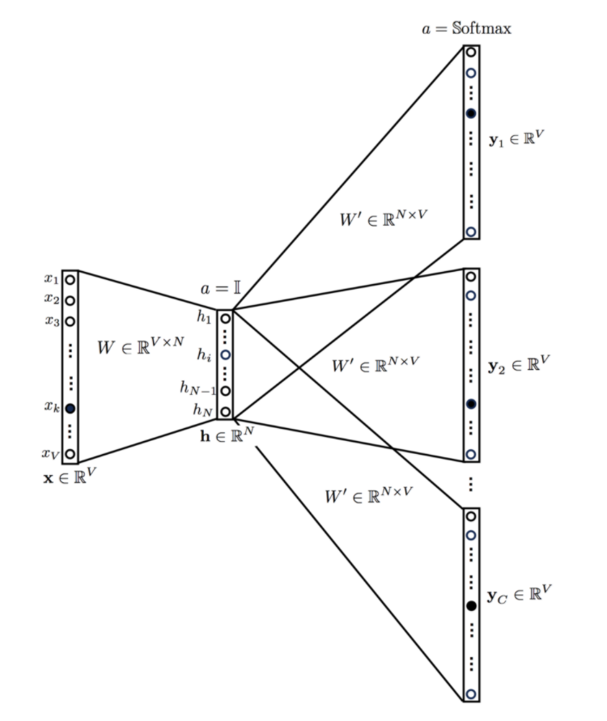
Skip Grams

Slide 17
Skip Grams
This looks like multiple-context CBOW model just got flipped. To some extent that is true.
We input the target word into the network. The model outputs C probability distributions. What does this mean?
For each context position, we get C probability distributions of V probabilities, one for each word.
In both the cases, the network uses back-propagation to learn. Detailed math can be found here

Slide 18
Skip Grams
The output probabilities are going to relate to how likely it is find each vocabulary word nearby our input word.
For example, if you gave the trained network the input word “Soviet”, the output probabilities are going to be much higher for words like “Union” and “Russia” than for unrelated words like “watermelon” and “kangaroo”.
We’ll train the neural network to do this by feeding it word pairs found in our training documents. The below example shows some of the training samples (word pairs) we would take from the sentence “The quick brown fox jumps over the lazy dog.” I’ve used a small window size of 2 just for the example. The word highlighted in blue is the input word.

Slide 19
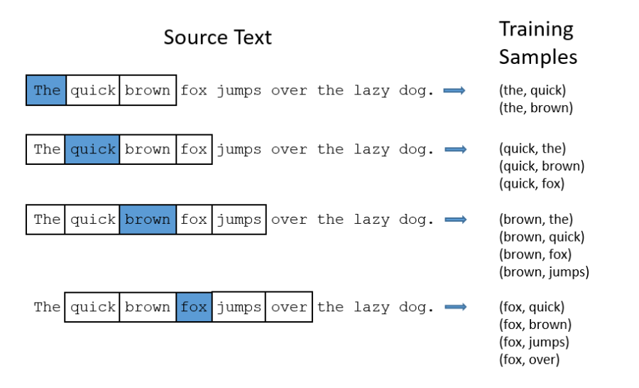
Skip Grams

Slide 20
Skip Grams
The network is going to learn the statistics from the number of times each pairing shows up. So, for example, the network is probably going to get many more training samples of (“Soviet”, “Union”) than it is of (“Soviet”, “Sasquatch”). When the training is finished, if you give it the word “Soviet” as input, then it will output a much higher probability for “Union” or “Russia” than it will for “Sasquatch”.

Slide 21
Who wins?
Both have their own advantages and disadvantages. According to Mikolov, Skip Gram works well with small amount of data and is found to represent rare words well.
On the other hand, CBOW is faster and has better representations for more frequent words.

Slide 22
Negative Sampling
For example, if we have word vectors with 300 features, and a vocabulary of 10,000 words. Recall that the neural network had two weight matrices–a hidden layer and output layer. Both of these layers would have a weight matrix with 300 x 10,000 = 3 million weights each!
Running gradient descent on a neural network that large is going to be slow. And to make matters worse, you need a huge amount of training data in order to tune that many weights and avoid over-fitting. millions of weights times billions of training samples means that training this model is going to be a beast.

Slide 23
Negative Sampling
Training a neural network means taking a training example and adjusting all of the neuron weights slightly so that it predicts that training sample more accurately. In other words, each training sample will tweak all of the weights in the neural network.
Negative sampling addresses this by having each training sample only modify a small percentage of the weights, rather than all of them.
With negative sampling, we are instead going to randomly select just a small number of “negative” words (let’s say 5) to update the weights for. (In this context, a “negative” word is one for which we want the network to output a 0 for). We will also still update the weights for our “positive” word (which is the word “quick” in our current example).

Slide 24
More about Skip Grams and CBOW
Loss functions and mathematic equations are all well explained in this paper.
(word2vec Parameter Learning Explained) Xin Rong

Slide 25
Glove
Glove is a word vector representation method where training is performed on aggregated global word-word co-occurrence statistics from the corpus.
This means that like word2vec it uses context to understand and create the word representations.
1. Global matrix factorization
In NLP, global matrix factorization is the process of using matrix factorization form linear algebra to reduce large term frequency matrices. These matrices usually represent the occurrences or the absence of words in the document.
2. Local context window
Local context window methods are CBOW and Skip-Gram, the one which were explained above.

Slide 26
Glove
The author of the paper mention that instead of learning the raw occurance probabilities, it was more useful to learn ratios of these co-occurence probabilities. The embeddings are optimized , so that the dot product of 2 vectors equals the log of number of times the 2 words will occur near each other.
For example, if 2 words “cat” and “dog” occur in the context of each other , say 20 times in 10-word window in the document corpus, then —
Vector(cat).Vector(dog) = log(10)
This forces the model to encode the frequency distibution of words that occur near them in a more global context.
GloVe: Global Vectors for Word Representation

Slide 27
Word Sense & Word Sense Disambiguation
Word sense disambiguation, in natural language processing (NLP), may be defined as the ability to determine which meaning of word is activated by the use of word in a particular context.
For example, consider the two examples of the distinct sense that exist for the word “bass” −
I can hear bass sound.
He likes to eat grilled bass.
The occurrence of the word bass clearly denotes the distinct meaning. In first sentence, it means frequency and in second, it means fish. Hence, if it would be disambiguated by WSD then the correct meaning to the above sentences can be assigned as follows −
I can hear bass/frequency sound.
He likes to eat grilled bass/fish.

Slide 28
Word Sense Disambiguation
Dictionary-based or Knowledge-based Methods
Supervised Methods
Semi-supervised Methods
Unsupervised Methods

Slide 29
Homework
Homework #1
Implement a one-hot encoding funcion
Take a simple paragraph and encode the words there using the one-hot encoding function created before

Slide 30
Thank you!

